Slide 1
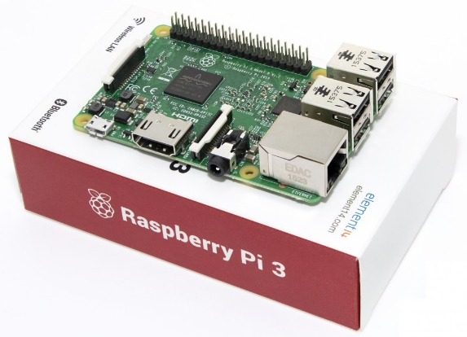

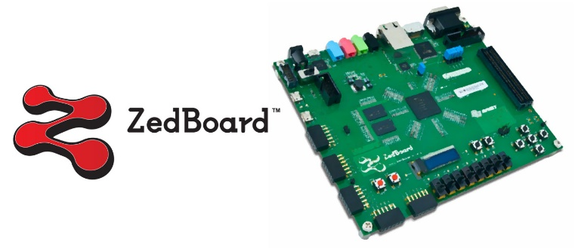
TensorFlow on ARMv7

Slide 2
TensorFlow?
TensorFlow, published by Google, is the powerful library which is capable of calculating Tensor which high-dimension matrix is called, providing useful methods for deep-learning.

Slide 3
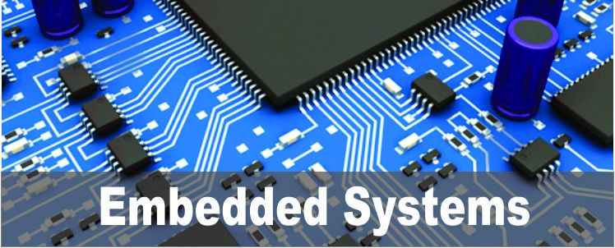

TensorFlow on Embedded system
ARM architecture for embedded system
Most of these systems embed ARM-architectural CPU
In order to install TensorFlow on embedded system, cross-compilation is needed to build architecture-specific object-files of TensorFlow.

Slide 4

STEP1: TensorFlow on Raspberry pi
ARM-cortex A15 processor which supports SIMD-based vector floating processing unit (neon-VFPv4) is deployed.
This Installation Procedure for TensorFlow is referenced by
https://github.com/samjabrahams/tensorflow-on-raspberry-pi

Slide 5

STEP1: TensorFlow on Raspberry pi
Hardware Dependency:
- MicroSD CARD required; above 16GB
- 1GB DRAM is equipped on the board
- Swap memory needed
- set enough size of Temporal directory (“/tmp”)
Software Dependency:
- Ubuntu MATE (easily get this in raspberry-pi homepage)
- linux package
python-(dev, virtualenv, pip), build-essential, libncurses5-dev, JDK (either open JDK source or Oracle JDK source)
pkg-config, zip, g++, zlib1g-dev, unzip, swig, gcc-4.8, g++-4.8
make_swap.sh
set_tmp.sh

Slide 6
STEP1: TensorFlow on Raspberry pi
1. Build BAZEL
Download Source files from Github/Bazel
bazel-0.4.5-dist.zip
Raspberry pi has not equipped physical memory enough to set java heap space automatically → set it manually
bazel/scripts/bootstrap/compile.sh - at line 117
Add “–j-Xmx500M”

Slide 7
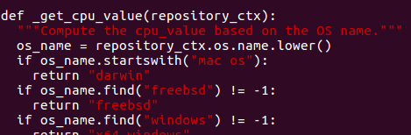
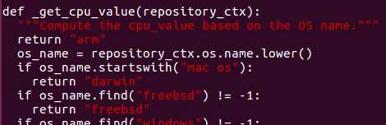

STEP1: TensorFlow on Raspberry pi
1. Build BAZEL
‘get_cpu_value’ function must be forced to return “arm”
Compile bazel…. It takes 5 hours in raspberry pi
Set PATH to use bazel in bash
bazel/tools/cpp/cc_configure.bzl - at line 133

Slide 8
STEP1: TensorFlow on Raspberry pi
2. Build TensorFlow
Download Source files from Github/Tensorflow.git
Checkout r1.0
Switch library files for 64-bit to 32-bit
When building TensorFlow, gcc-complier must keep recognizing raspberry-pi as mobile system
tensorflow/core/platform/platform.h - at line 48

Slide 9
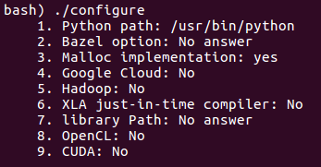
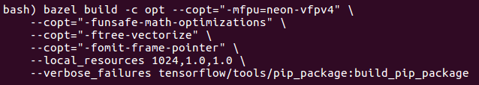
STEP1: TensorFlow on Raspberry pi
2. Build TensorFlow
Configure option
Build Option
depends on versions of TensorFlow
takes 6 hours in raspberry-pi

Slide 10

STEP1: TensorFlow on Raspberry pi
2. Build TensorFlow
Install TensorFlow
mock, python package, must be reinstall
~/tensorflow/

Slide 11
STEP2: TensorFlow on Zedboard
Overview
ARM-Cortex A9 which supports vector floating point unit (vfpv3) is equipped on Zedboard.
Higher Linaro-Linux versions required than Desktop-Linux for GCC-library supports. → version 15.x higher experimentally

Slide 12
STEP2: TensorFlow on Zedboard
Hardware Dependency:
- SD CARD required; above 16GB
- 512MB DRAM is equipped on the board
- Swap memory needed
Software Dependency:
- Linaro 15.x higher (easily get this in linaro-archive)
- linux package
python-(dev, virtualenv, pip), build-essential, libncurses5-dev, JDK (either open JDK source or Oracle JDK source)
pkg-config, zip, g++, zlib1g-dev, unzip, swig, gcc-4.8, g++-4.8
software-properties-common (add-apt-repository)
add-apt-repository ppa:openjdk-r/ppa → for openJDK

Slide 13
STEP2: TensorFlow on Zedboard
Difference between Raspberry-pi and Zedboard
Processor of Zedboard has v3. Vector Floating Point (vfpv3) units.
Less of physical memory space
Numpy is not able to be installed automatically → build manually
Bazel can be installed in the same way that on Raspberry-Pi
Configuration of TensorFlow is same as Raspberry-Pi
<Conclusion>
Build bazel and configure TensorFlow in the same way
When compiling TensorFlow, determine appropriate compile options

Slide 14

STEP2: TensorFlow on Zedboard
1. Build NUMPY
Download Source files from Github/numpy
Checkout tags/v1.11.0
Software-dependency for Numpy
Linux-package: gfortran liblapack-dev libopenblas-dev
/usr/include/sys/endian.h doesn’t exit, but in /usr/include cd /usr/include/sys; ln –s ../endian.h endian.h
Install Numpy

Slide 15
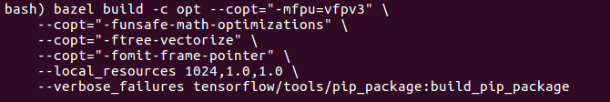
STEP2: TensorFlow on Zedboard
2. Build TensorFlow
- Compile option
Since processor of Zedboard supports vfpv3 Floating Point units,
The ‘-mfpu=vfpv3’ option of cross-compiler is required.
Takes 12 to 13 hours to compile it.

Slide 16
STEP2: TensorFlow on Zedboard
2. Build TensorFlow
Install TensorFlow
mock, python package, must be reinstall
~/tensorflow/

Slide 17
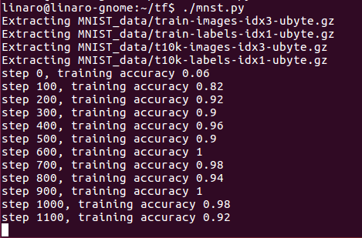
STEP2: TensorFlow on Zedboard
2. Build TensorFlow
Run examples: MNIST

